Slide 1
Focus on Robot Learning

Slide 2
Robot Learning
Basics: kinematics, statistics, ROS.
Sensing: Filtering and state estimation
  (Particle filters, Kalman filters)
Supervised Learning, HMM.
Perception (Kinect, Point-cloud library, algorithms)
Reinforcement Learning and Control.

Slide 3
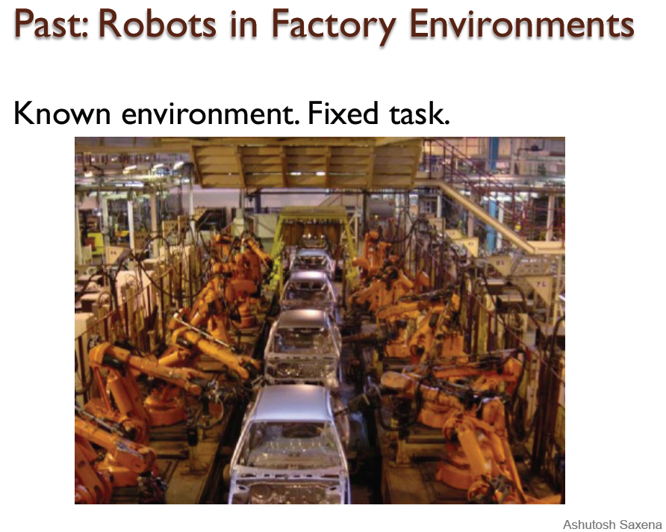

Slide 4
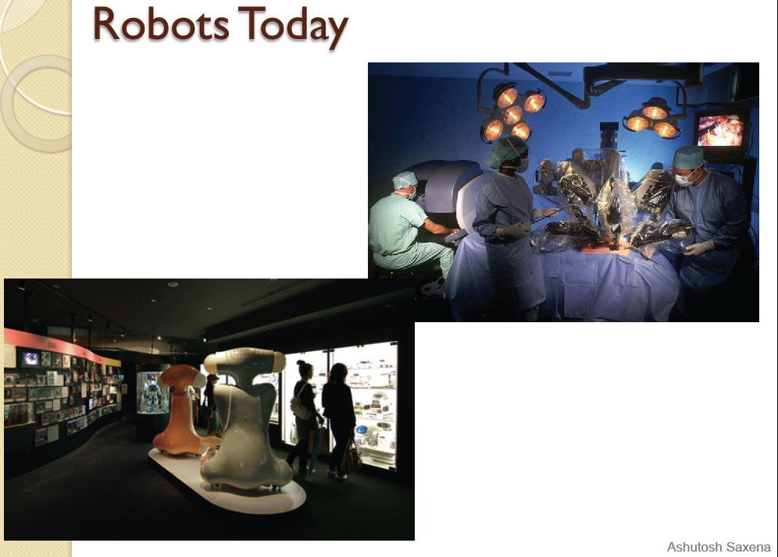

Slide 5
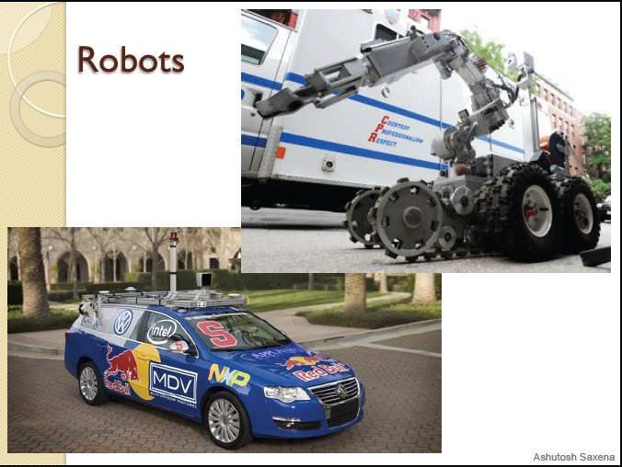

Slide 6
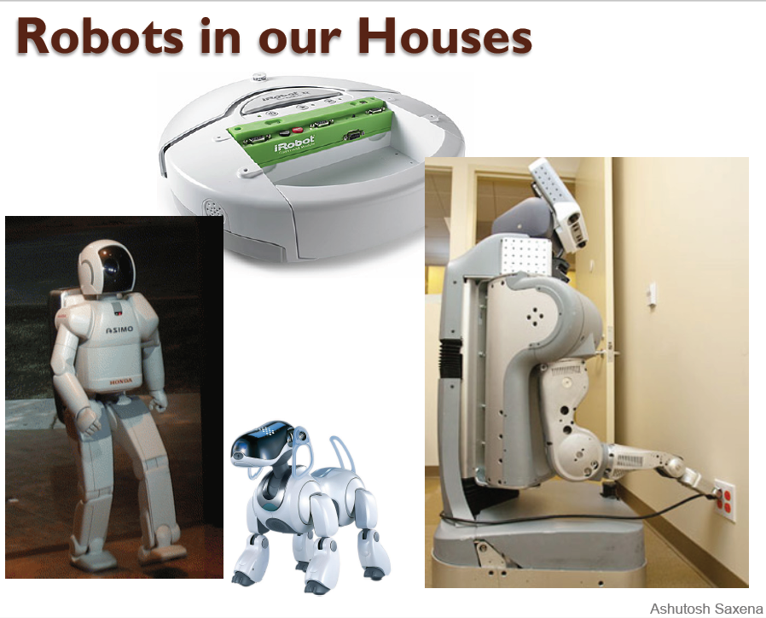

Slide 7
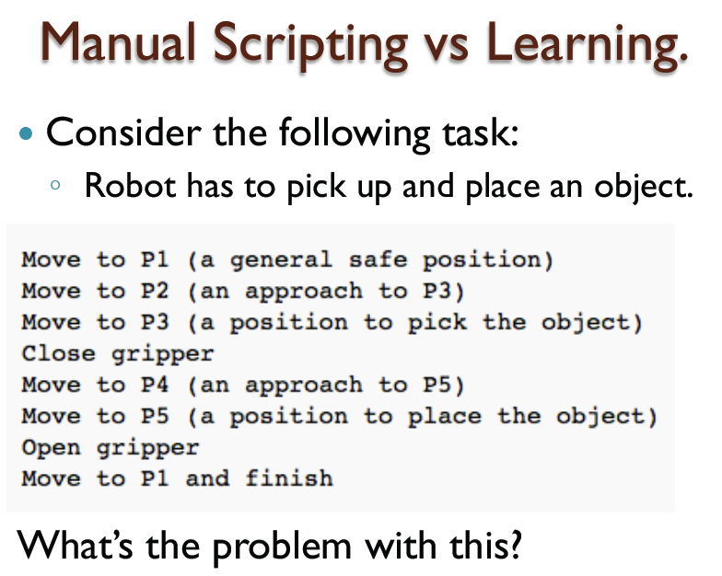

Slide 8
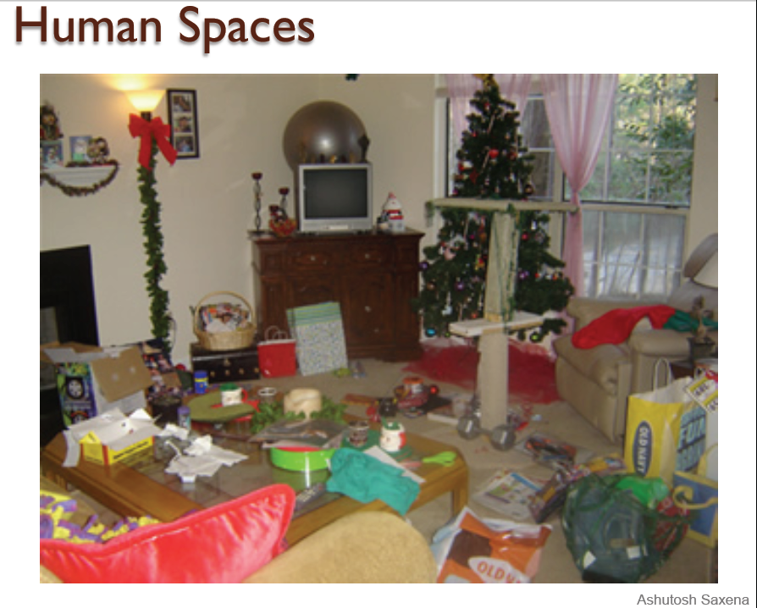

Slide 9
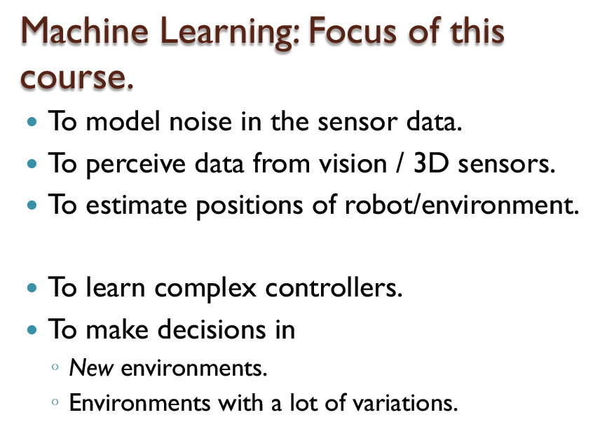

Slide 10
What are you expected to do and know?
Probability, statistics and Linear algebra.
Strong mathematical skills are required.
Robotics involves a lot of hard-work and hacking.
“It is never wise to let a robot know that you are in a hurry.”

Slide 11
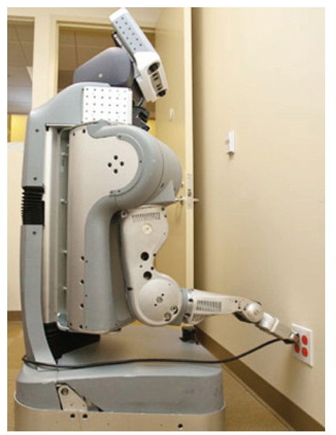
Areas of Robot Learning

Slide 12
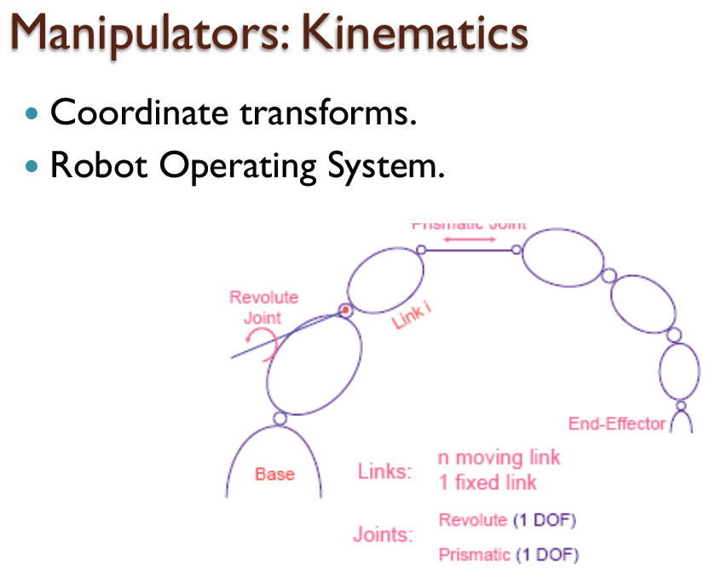

Slide 13
Vision and Perception
Basic computer vision.
Learning algorithms for 3D perception,
  e.g., from sensors such as Microsoft Kinect.
  Point-cloud library.

Slide 14
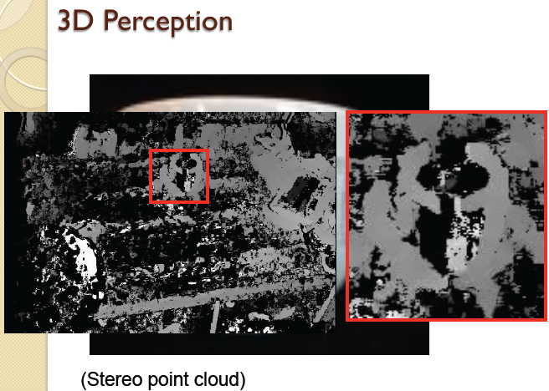

Slide 15
Learning algorithms
Supervised Learning: k-NN, SVM, etc.
  Given the noisy sensor data, estimate the desired output.
Hidden Markov Models and Kalman Filters.
State estimation and modeling temporal behavior.

Slide 16
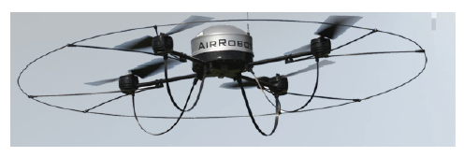

Slide 17
Control/Decision Making
Markov Decision Processes.
Reinforcement Learning and Control

Slide 18
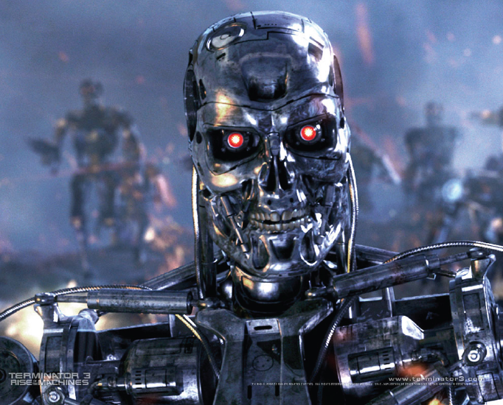

Slide 19
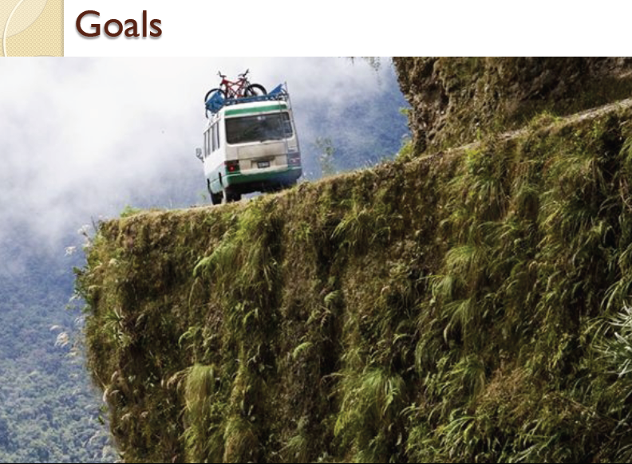

Slide 20
Goals encoded as a Cost Function
  Which areas on the road are good?

Slide 21
Optimizing cost function:
Descent Methods
General descent algorithm
Generalization to multiple dimensions
Problems of descent methods, possible improvements.
Fixes
Local Minima

Slide 22
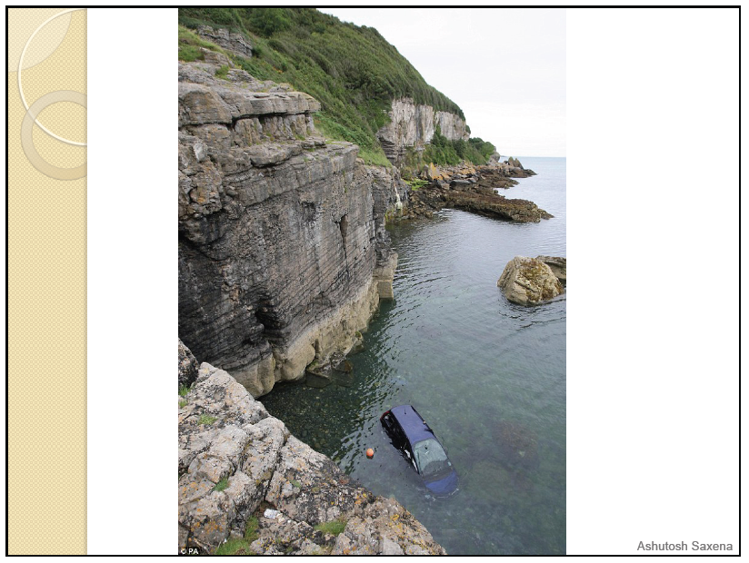

Slide 23
Minimization by Gradient Descent:

Slide 24
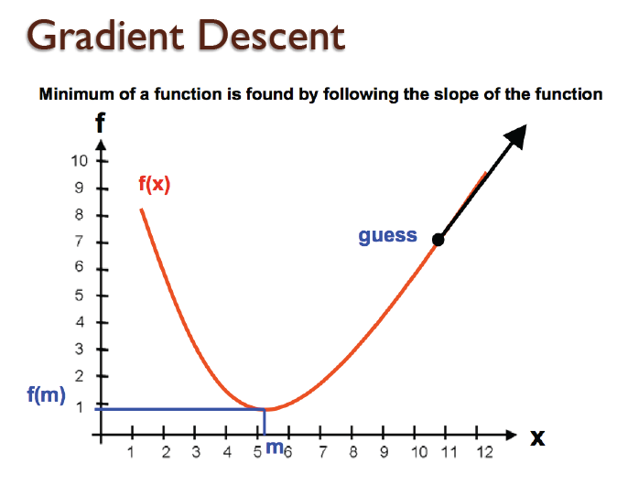

Slide 25
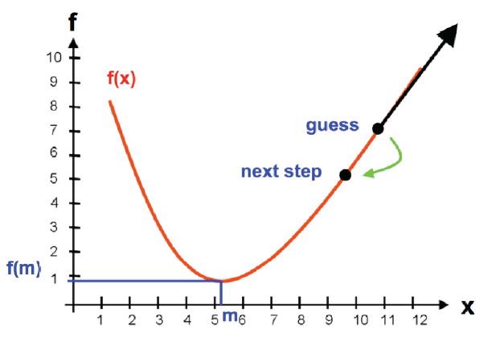

Slide 26
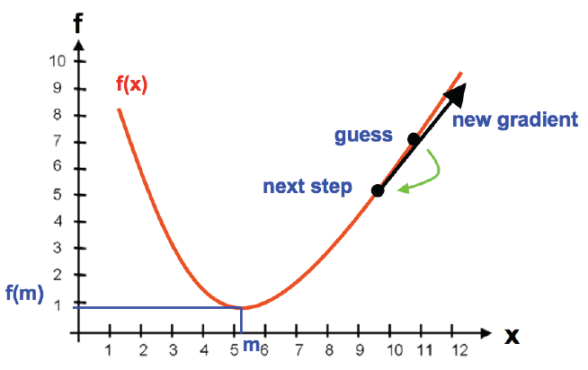

Slide 27
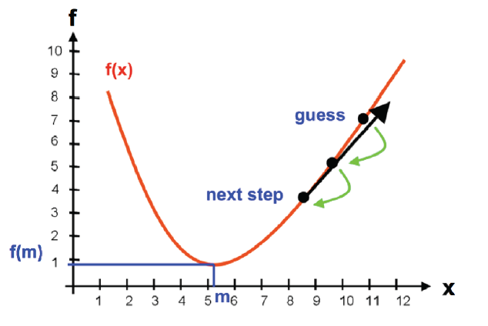

Slide 28
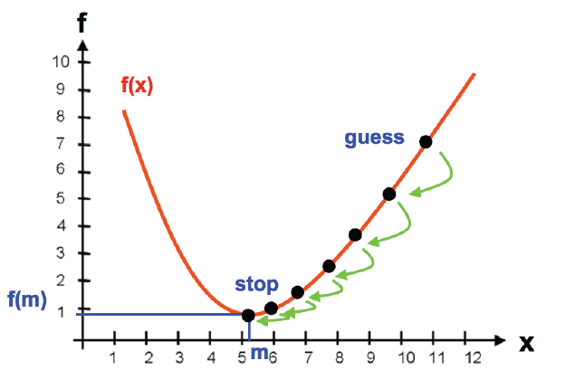

Slide 29
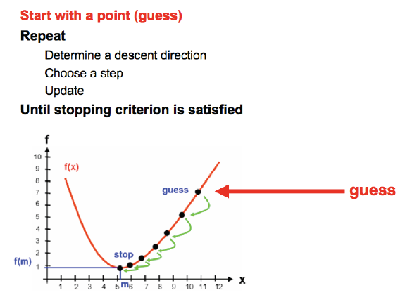

Slide 30
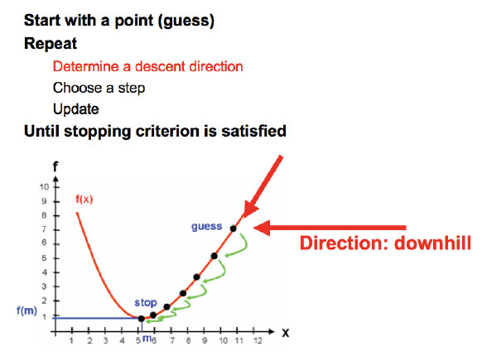

Slide 31
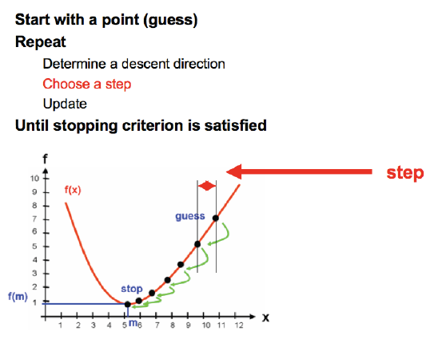

Slide 32
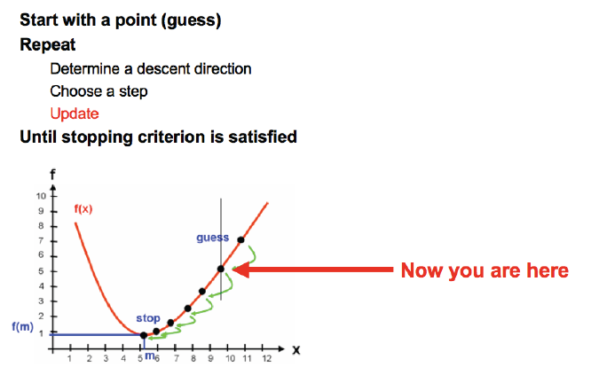

Slide 33
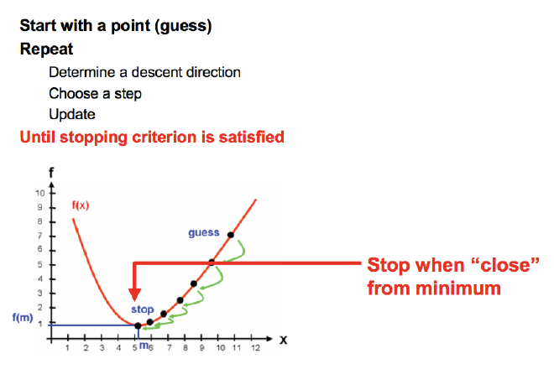

Slide 34
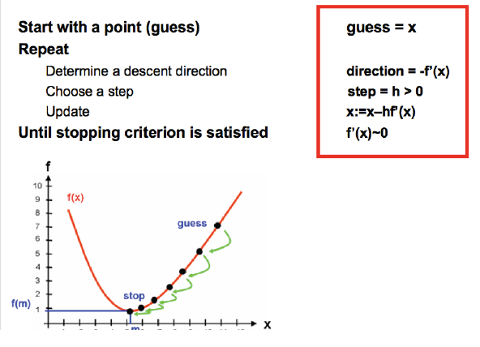

Slide 35
Matlab Demo

Slide 36
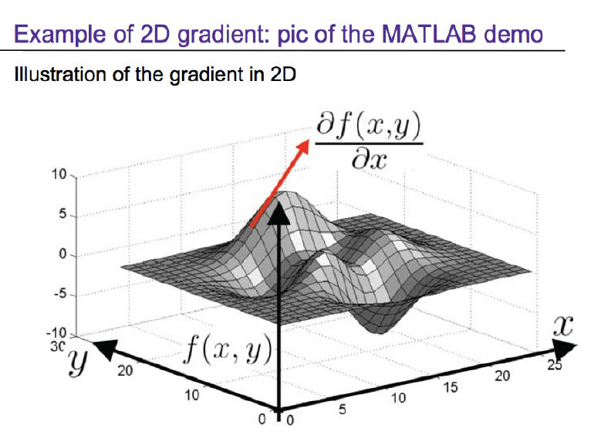

Slide 37
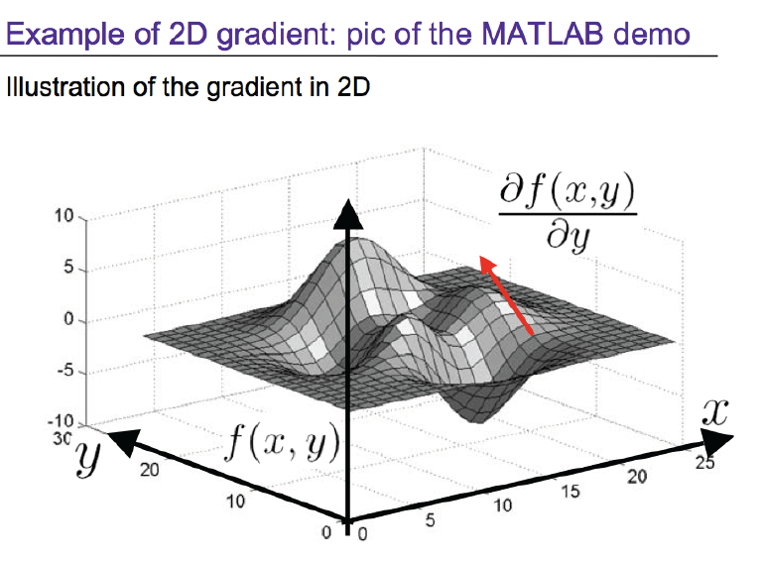

Slide 38
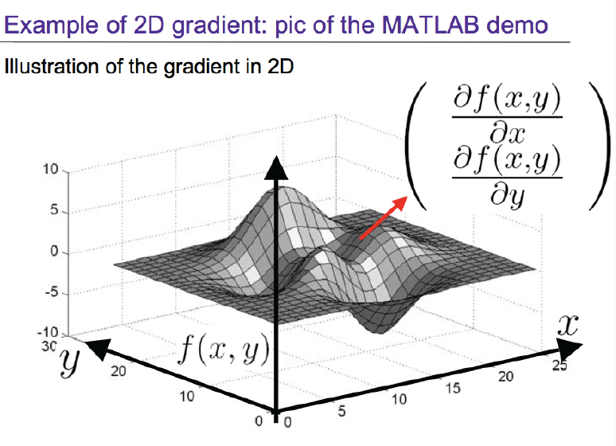

Slide 39
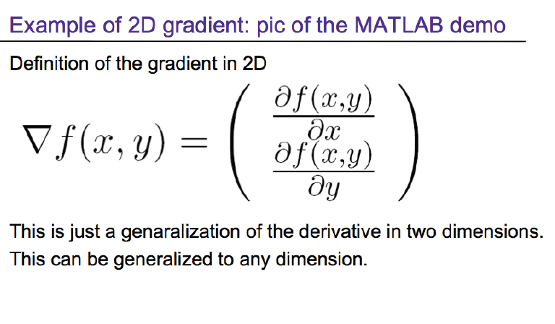

Slide 40
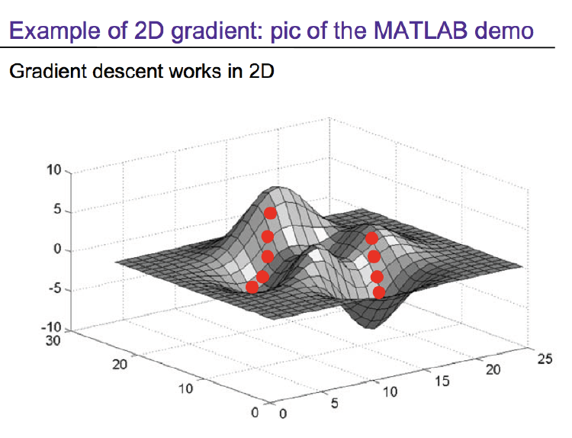

Slide 41
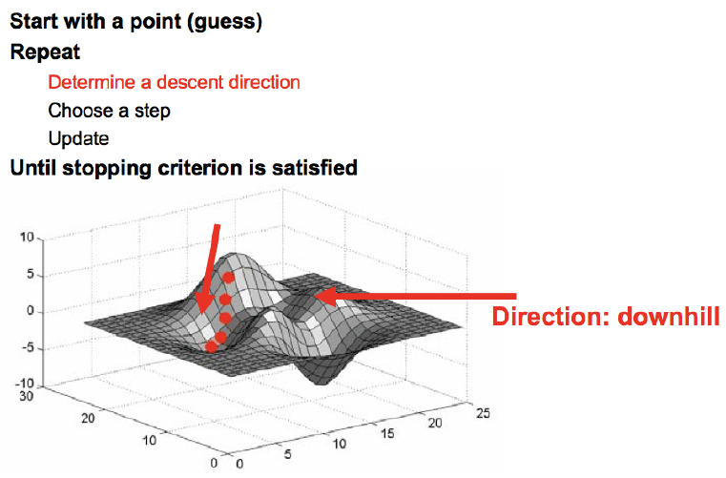
Generalization to multiple dimensions

Slide 42
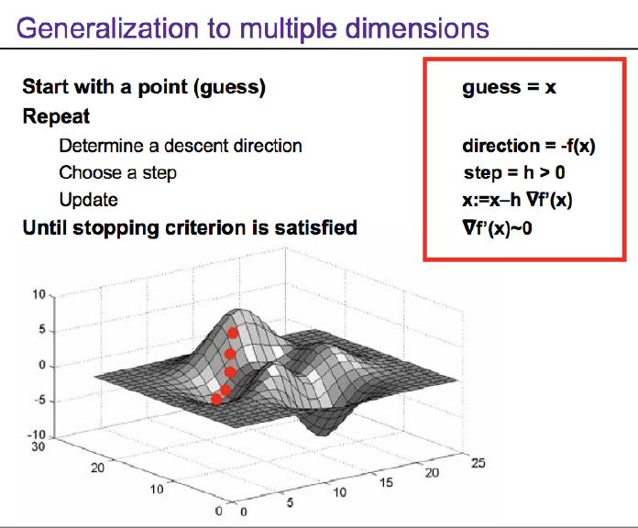

Slide 43
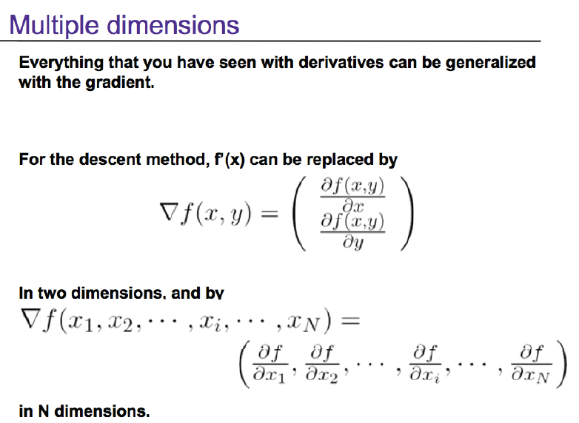

Slide 44
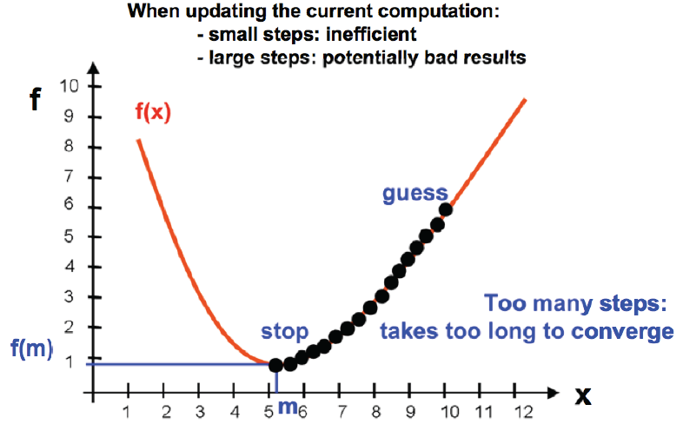
Problem 1: choice of the step

Slide 45
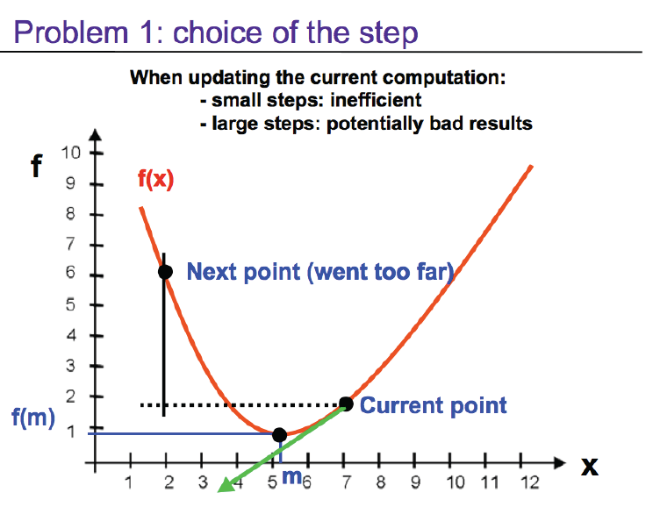

Slide 46
Solution to step size
Back-tracking line search.
  Step-size = step-size / 2
  Until new function value gets smaller.

Slide 47
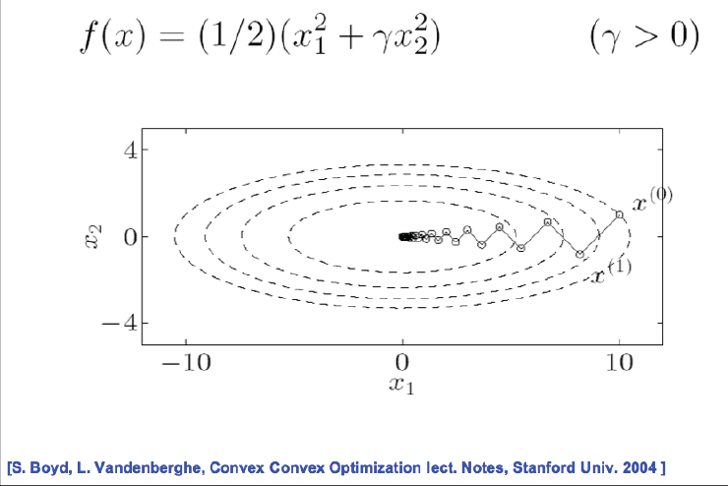
Problem 2: “Ping Pong effects”

Slide 48
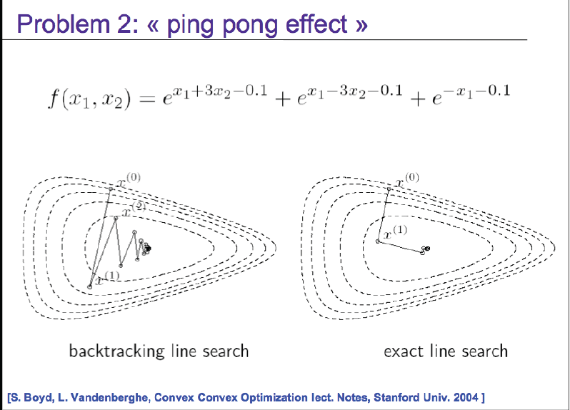

Slide 49
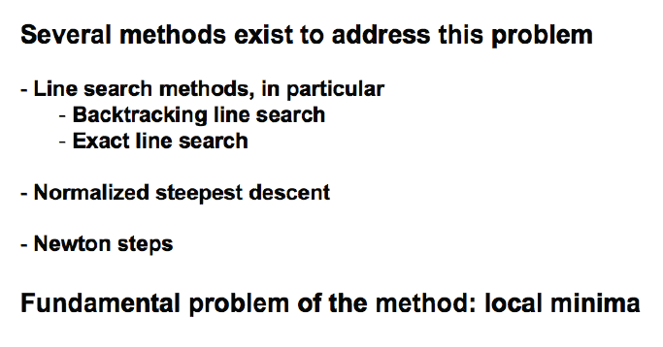
Fixes to ping-pong

Slide 50
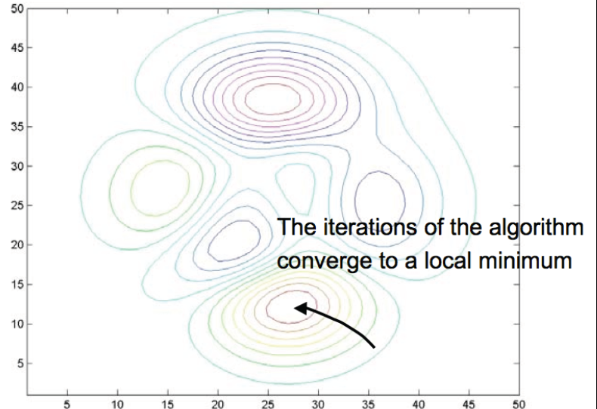
Local Minima

Slide 52
Ashutosh Saxena

Slide 53
Develop/implement learning algorithms for two robots.
  Aerial Robot.
  Personal Robot.
http://www.cs.cornell.edu/Courses/cs4758/2012sp/projects.html

Slide 54
